Slide 1

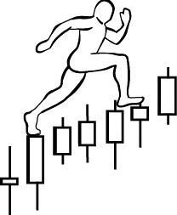
Group Exercise
and
Homework #7:
Exercise: Volume and Price Analysis
Price Structural Analysis
Assignment:
Identify the dominance of Supply or Demand on a single bar or a swing
Combine Price Structural Analysis with Volume Analysis
Make your determination about the next most probable price action
Label trading ranges with Wyckoff Phases and events
Watch the video of this exercise again and make notes. Email the notes to Roman.
www.WyckoffAnalytics.com Copyright © 2019 Wyckoff Associates, LLC. All Rights Reserved.

Slide 2
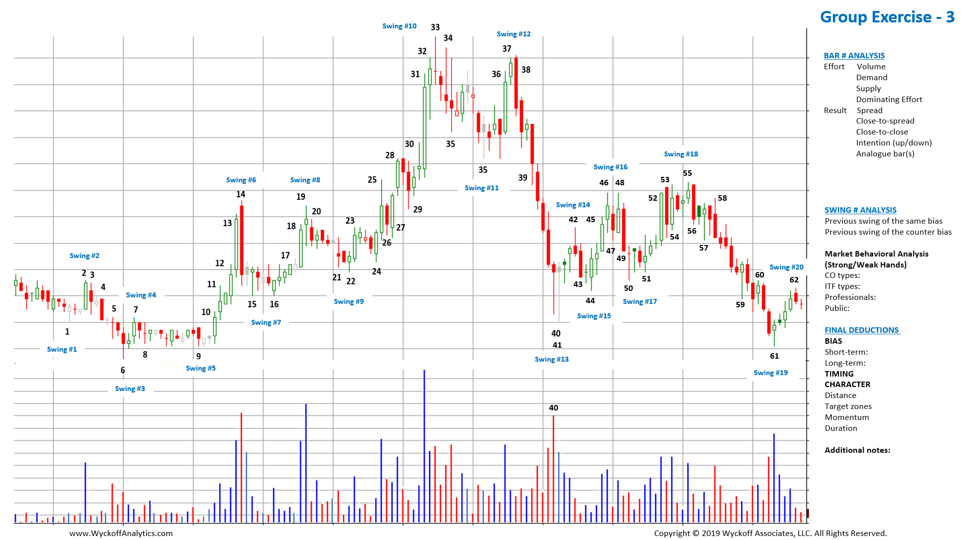

Slide 3
